Slide 1
Modernize Your Monolith
With EventStorming
Sarah “sadukie” Dutkiewicz
Notes:
Modernizing legacy monoliths is a daunting task, but EventStorming offers a clear path forward. Join us as we show how you can use EventStorming to deconstruct your monolithic .NET applications and migrate them towards a microservices architecture. This session will provide actionable insights into the EventStorming process, highlighting how it helps align technical and business teams while reducing risks and ensuring a smooth transition.

Slide 2
Agenda
What do we need to consider going from monolith towards microservices?
What is EventStorming?
What are the Types of EventStorming?
How does EventStorming help with Modernization?
How do you get started with EventStorming today?

Slide 3
Modernization Considerations
Notes:
These are some things to consider when modernizing a monolith towards microservices.

Slide 4
Things to Think About When Modernizing
Domain Boundaries
Data Management
Is the domain clearly broken out?
If not, how do we break out the code in modules or microservices?
Does data need to migrate?
If so, how do we migrate from one data store to another?
Infrastructure
Technical Debt
Do we need to migrate from a single instance to containerized solutions?
Do we need to migrate APIs? If so, can we migrate it incrementally using something like the Strangler Fig approach?
Can we reduce some of the existing technical debt as part of our modernization efforts?
Can we reduce risks and improve maintainability as part of modernization?
Notes:
1. Domain Boundaries – If your monolith isn’t broken up into reasonable pieces, don’t panic. This is where EventStorming will help!
2. Data Management – As you have conversations about modernizing, you may realize that the way you store data may also need to evolve in the modernization process. Again – don’t panic! You may realize these things in the EventStorming discussion.
3. Infrastructure – This may be another conversation that comes up as part of EventStorming.
4. Technical Debt – This is a normal topic that comes up in modernization discussions.

Slide 5
What is EventStorming?
Collaborative workshop-based experience to gain a shared understanding of a complex business system

Slide 6
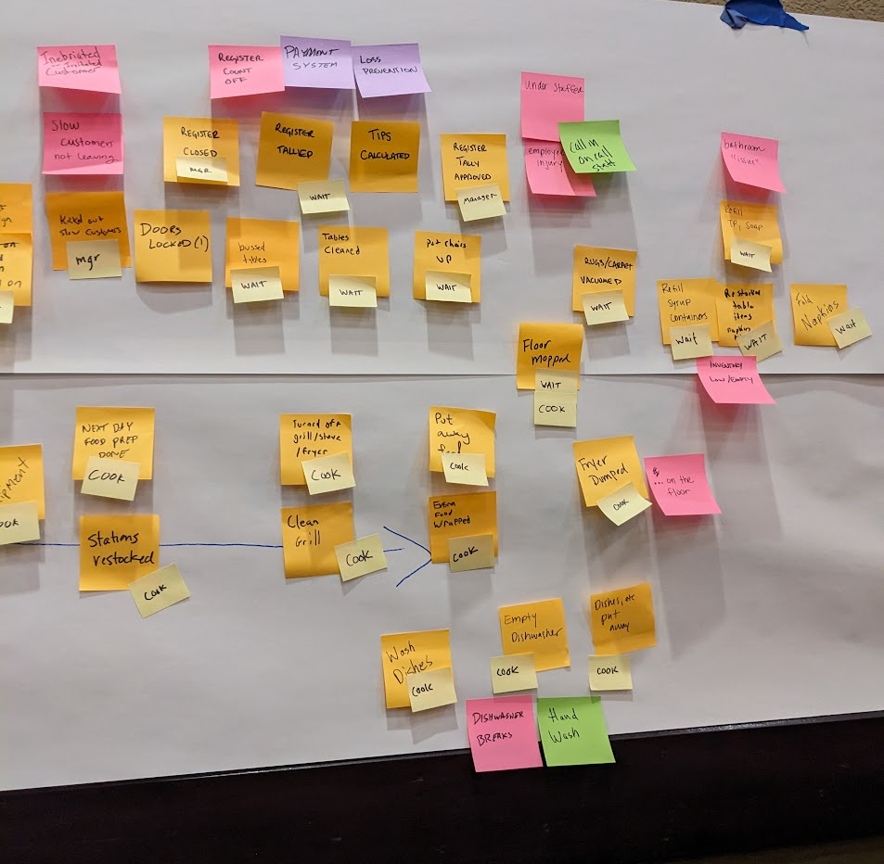
EventStorming in Action
Lots of sticky notes and conversations – building a shared understanding and getting towards a solution
Notes:
This is a sample of what EventStorming can look like – lots of sticky notes with different colors and sizes. The sticky notes are used to help facilitate discussions and capture key points. We’ll look at the different colors and how they matter in a bit.

Slide 7
Key People in EventStorming
Facilitator
People with questions
People with answers
Notes:
People with answers = subject matter experts, domain experts, people who know how processes and systems work

Slide 8
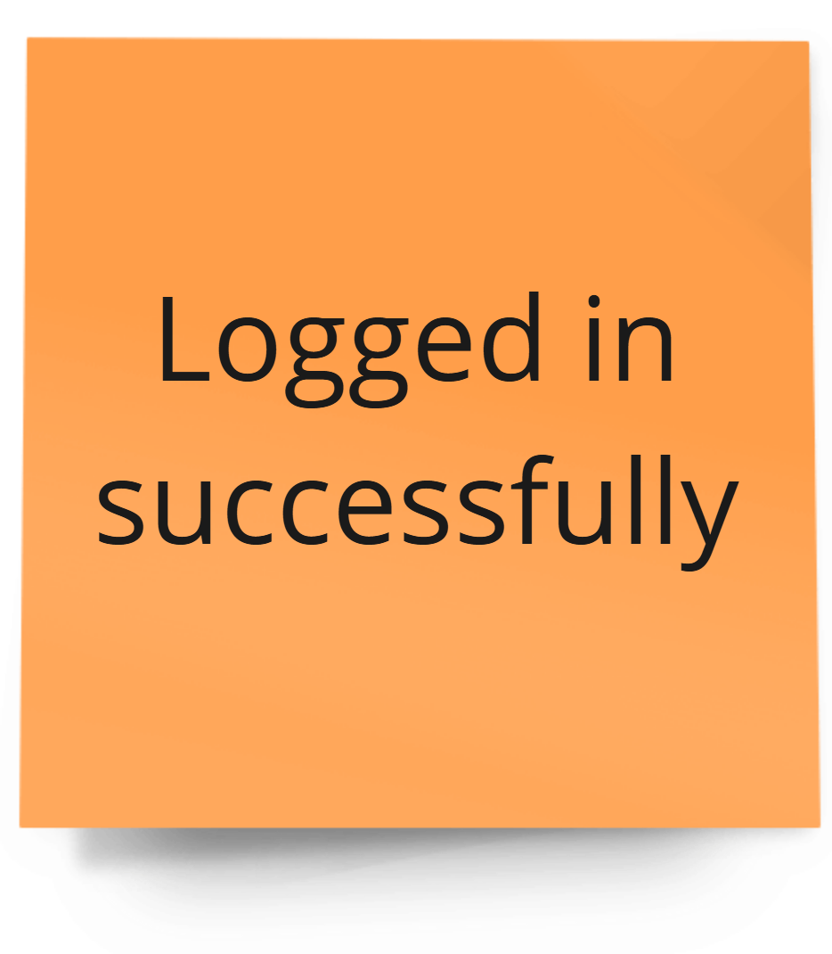
And so it begins… What happened?
Notes:
It starts with one sticky note.
Orange sticky notes are events – the Event part of EventStorming.
The facilitator asks the group how something happened and has everyone write their version of the events. (The Storming part of EventStorming) Each event sticky note is written in past tense.
In the next round, things get deduplicated.
The different EventStorming types take different paths from here.
So think of it as… conversations with sticky notes… with more!

Slide 9
What are the types of EventStorming?

Slide 10
Types of EventStorming
Big Picture
Process Modeling
People Experience
Goal: Generate shared understanding
Used for discovery
Goal: Address the Hotspots
Used for exploring a process
Typically limited to a single end-to-end process
Goal: Understand customer/user/ persona interactions and experiences
System Design
Refactoring
Goal: Evaluate a system and propose a solution
Design a solution
Be aware of alternatives
Hide unnecessary complexity from the users
Given an existing solution, use EventStorming to identify what is available and potential refactor points
Notes:
If you read either of the books on EventStorming, you’ll see Big Picture, Process Modeling, and System Design.
I’ve added types of Refactoring and People Experience.
I see system design as greenfield and refactoring as brownfield.
As for People Experience, I take Process Modeling a step further and look at the impacts and how we can get better experiences.

Slide 11
What if all you have is a Legacy Monolith?
While you can build upon discussions in other EventStorming sessions, they are not prerequisites for refactoring.
No prior EventStorming session needed for refactoring discussions.

Slide 12
How does EventStorming help with Modernization?

Slide 13
Benefits of EventStorming in Modernization
Shared Understanding
Domain-Driven Design Alignment
Identification of Bounded Contexts
Early Detection of Bottlenecks and Issues
Improved Communication and Collaboration
Accelerated Decomposition
Notes:
Shared Understanding: EventStorming brings together diverse stakeholders, including developers, business analysts, and domain experts, to collaboratively explore the system's domain. This shared understanding fosters communication, reduces ambiguity, and aligns everyone on the problem space.
Domain-Driven Design (DDD) Alignment: EventStorming naturally aligns with DDD principles by focusing on the domain's core concepts, events, and processes. This helps identify bounded contexts, aggregate roots, and domain services, which are crucial for effective microservices decomposition.
Identification of Bounded Contexts: EventStorming helps visualize the boundaries of different subdomains within the monolith, enabling the identification of potential microservices. By understanding how events flow and where data is owned, you can define clear service boundaries.
Early Detection of Bottlenecks and Issues: The visual nature of EventStorming allows you to spot potential bottlenecks, inconsistencies, and areas of complexity early in the modernization process. This enables proactive problem-solving and risk mitigation.
Accelerated Decomposition: By providing a clear, visual representation of the domain, EventStorming accelerates the decomposition process. Teams can quickly identify potential microservices and their responsibilities, reducing the time and effort required for architectural design.
Improved Communication and Collaboration: EventStorming fosters effective communication and collaboration among team members. The visual nature of the diagrams and the interactive nature of the process make it easier for everyone to understand the system's complexity and contribute to the design.

Slide 14
How do you get started with EventStorming for Modernizing an App?
Notes:
This goes to the “It depends” part. How much of a shared understanding is there of the monolith? What are the goals in the modernization process? Any of the EventStorming situations can be applied. Let’s look at when you would use which one.

Slide 15
Need to understand the domain?
Big Picture EventStorming
Notes:
Sometimes, with a monolith, you have that 1 person who has all the knowledge. They have a wealth of domain knowledge, having been the caretaker of that monolith for the past few decades. Or you have business people and techies who are not aligned about what the monolith should do. Sometimes, you have to have the conversation to level set on the domain. The goal with Big Picture EventStorming is discovery and building a shared understanding.

Slide 16
Need to understand processes within the system?
Process Modeling EventStorming
Notes:
With the systems we maintain, they can be complex. Process Modeling EventStorming allows us to explore those processes, identify the unknowns as well as the pain points. The goal is to address as many of the pain points as possible.

Slide 17
Need to understand processes within the system and how they impact the users?
People Experience EventStorming
Notes:
Sometimes, as people are modernizing their applications, they are also enhancing their people experience. Commonly, this is user experience. However, if you are a creator of developer tools, you also have to consider developer experience. And if you have a white label product, you have users who use your product and interact with their customers. So then customer experience becomes a thing to consider as well. Many people overlook these situations, which is why I point out that EventStorming can be used for exploring those experiences further.

Slide 18
Trying to figure out the modules for modular monoliths or microservices?
Refactoring EventStorming
Notes:
Refactoring EventStorming allows you to explore what’s already out there and figure out how to refactor it into something else. In the case of going from a monolith towards microservices – and maybe stopping at a modular monolith along the way – this EventStorming helps you see what you already have and how the initial design evolved over time. It allows you to see how things are currently grouped and have the conversations about restructuring them, making modules that might make more sense than in the current app.

Slide 19
Lucky enough to start greenfield?
System Design EventStorming
Notes:
System Design EventStorming allows you to explore solutions for a greenfield system design. In the case of going from a monolith towards microservices – and maybe stopping at a modular monolith along the way – this EventStorming helps you see what you already have and how the initial design evolved over time. It allows you to see how things are currently grouped and have the conversations about restructuring them, making modules that might make more sense than in the current app.

Slide 20
It starts with one…
Notes:
It starts with one sticky note.
Orange sticky notes are events – the Event part of EventStorming.
The facilitator asks the group how something happened and has everyone write their version of the events. (The Storming part of EventStorming) Each event sticky note is written in past tense.
In the next round, things get deduplicated.
Then it could follow the path of system design and refactoring, where things get grouped by similar “areas” – which we call bounded contexts in Domain-Driven Design.
Finally, as entities are understood and composition makes sense, aggregates are identified. So think of it as… conversations with sticky notes… with more!

Slide 21

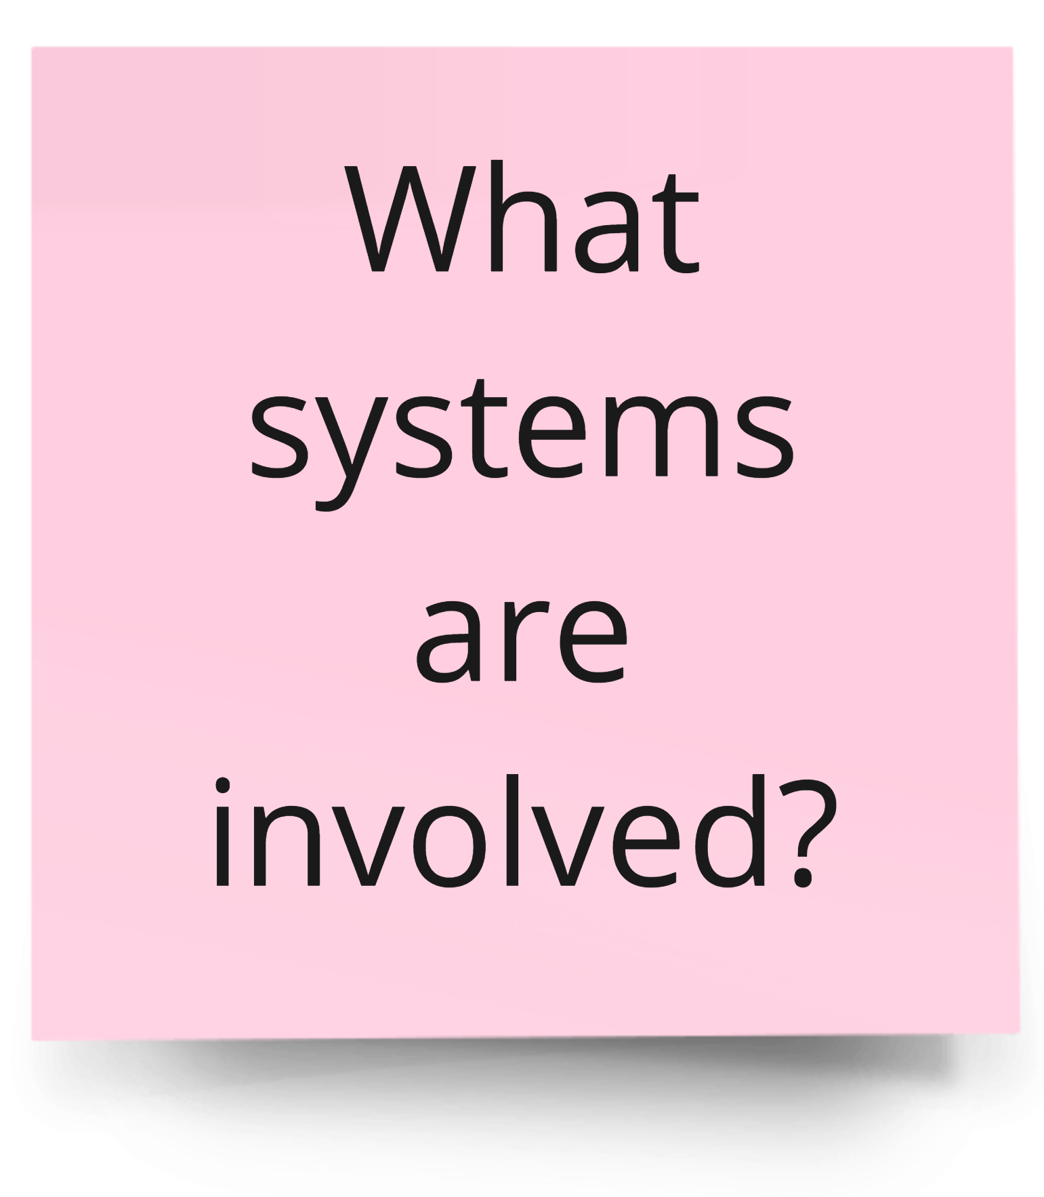
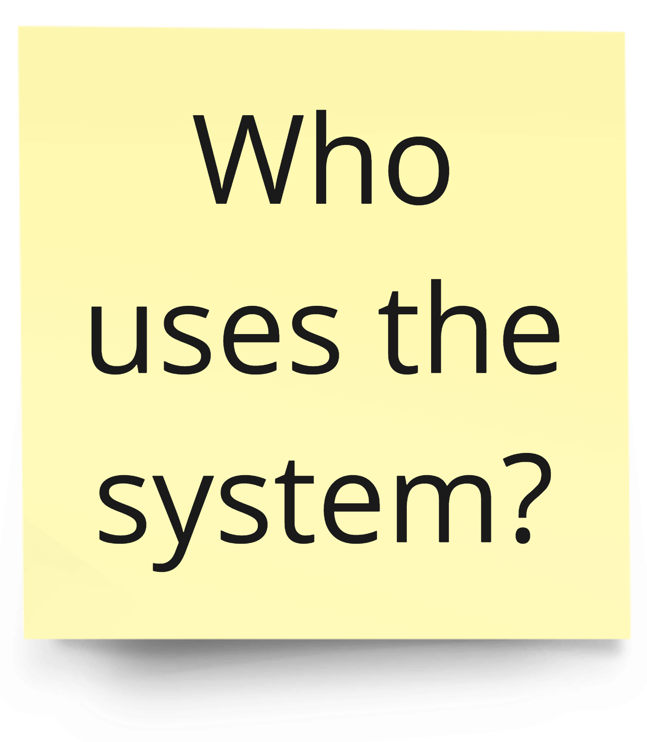
EventStorming for Refactoring – Basic Sticky Notes
Users/Roles/Personas
Systems
Domain Events
Notes:
Think of EventStorming for Refactoring as a combination of Big Picture and System Design. We need discovery before we can identify the small parts.

Slide 22
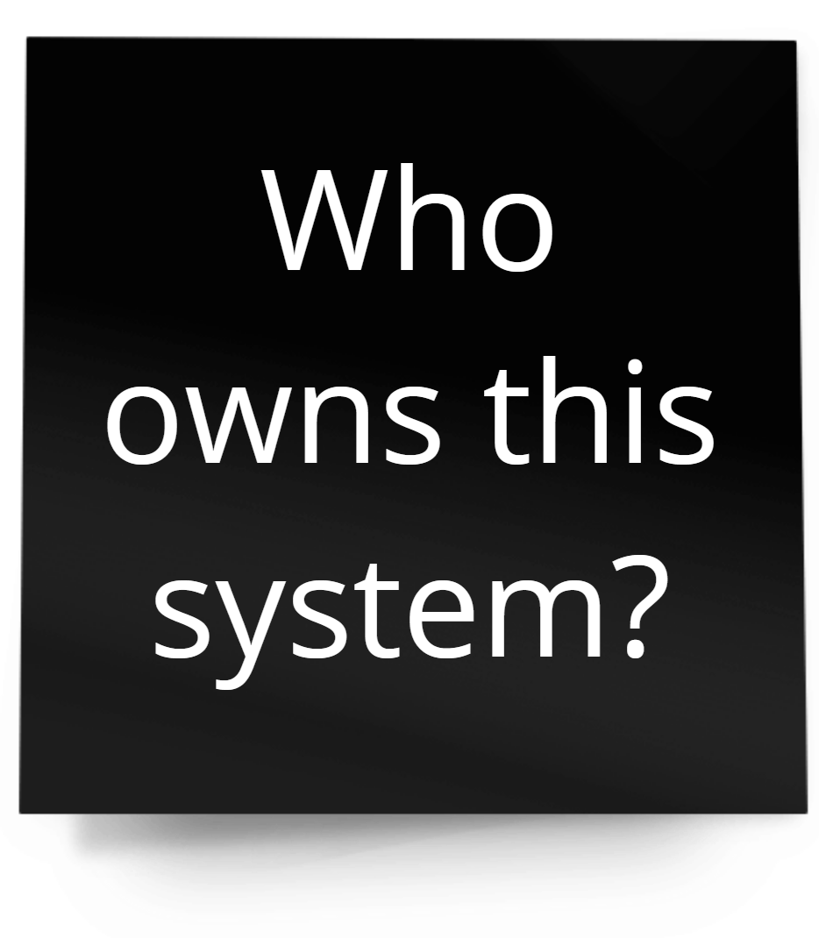
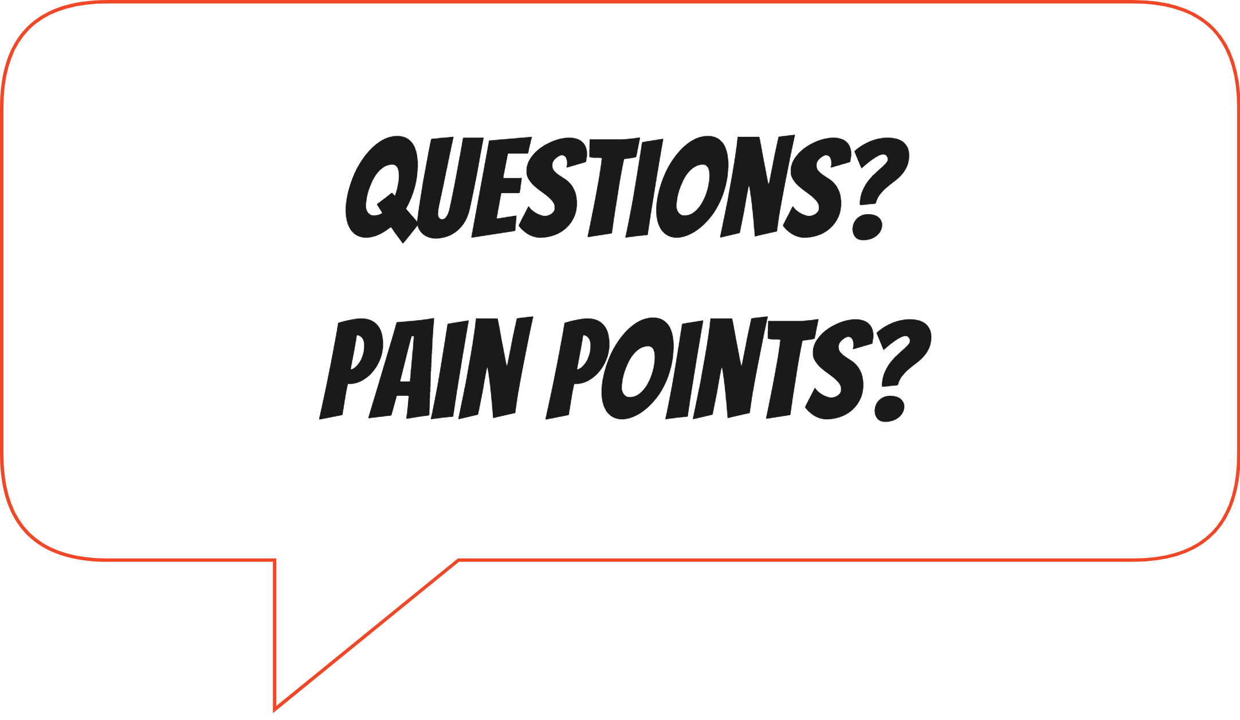
Identify Hotspots
Notes:
Hotspots represent: - Questions
- Risks/Warnings
- Assumptions

Slide 23
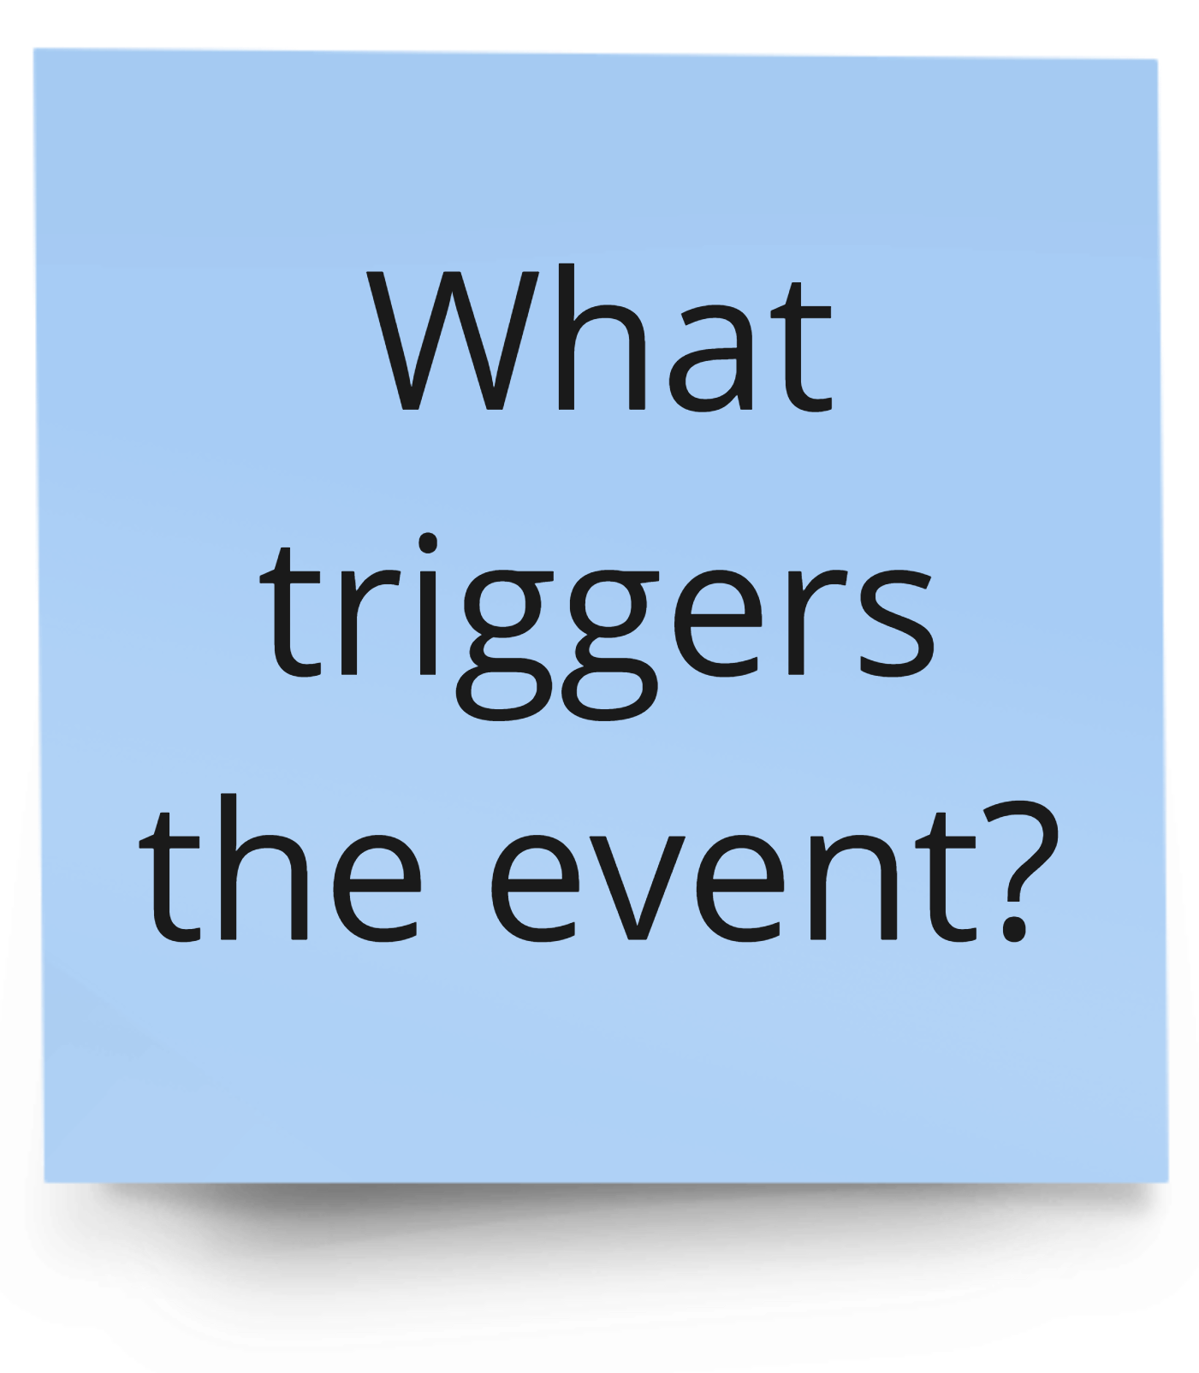
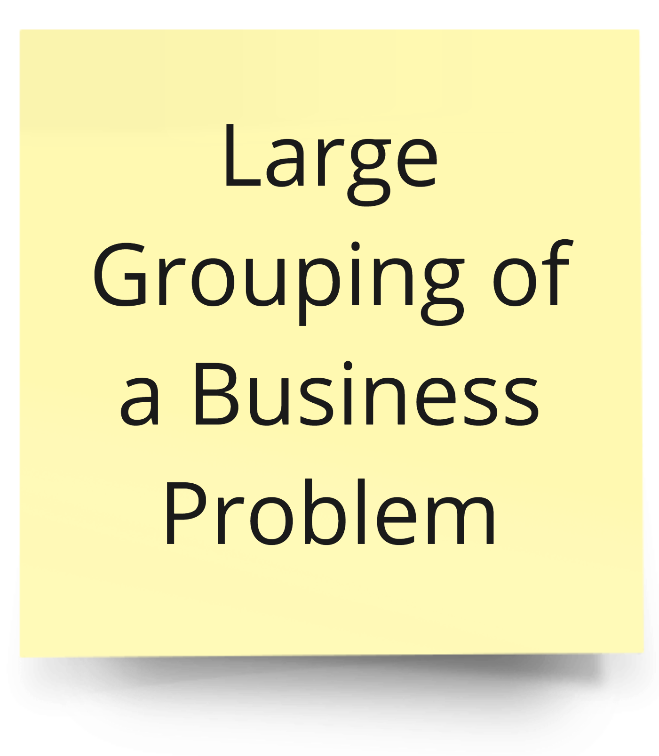
EventStorming for Refactoring – Additional Sticky Notes
Command
Aggregate

Slide 24

Animated eCommerce demo of EventStorming
On this slide, an example of EventStorming is animated. First, an event "Added item to cart" appears. Then, other orange sticky notes fly in from various parts of the screen, simulating the storming part of EventStorming. Other events include "Entered shipping information", "Shipping costs calculated", "Processed the order", "Searched order history for order status", "Delivered the order", "Payment accepted", "Order submitted", "Entered payment details", "Sales tax calculated", and "Clicked Checkout".
Entered shipping information
Shipping costs calculated
Added item to cart
Sales tax calculated
Entered payment details
Clicked Check Out
Searched
for item
Payment accepted
Order submitted
Processed the order
Searched order history for order status
Delivered the order

Slide 25
Events all in place before separation
On this slide, the storm of events is animated to show the sorting of events. Events with similar themes are gathered.
"Added item to cart" is on its own. "Searched for item", "Clicked Check Out", and "Searched for order status" are grouped.
The rest of the events were grouped into their own group. This group includes "Entered shipping information", "Shipping costs calculated", "Processed the order", "Sales tax calculated", "Entered payment details", "Payment accepted", "Delivered the order", and "Order submitted".
Entered shipping information
Shipping costs calculated
Added item to cart
Sales tax calculated
Entered payment details
Clicked Check Out
Searched
for item
Payment accepted
Order submitted
Processed the order
Searched order history for order status
Delivered the order

Slide 26
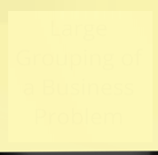
Dividing the sorted events into aggregates
Now that the events are sorted, we can identify loose boundaries related to these events.
"Added item to cart" belongs to a Cart. "Searched for item", "Clicked Check Out", and "Searched for order status" belong to a Customer.
The rest of the events belong to Order. This group includes "Entered shipping information", "Shipping costs calculated", "Processed the order", "Sales tax calculated", "Entered payment details", "Payment accepted", "Delivered the order", and "Order submitted".
Entered shipping information
Processed the order
Added item to cart
Cart
Sales tax calculated
Entered payment details
Order
Payment accepted
Clicked Check Out
Customer
Shipping costs calculated
Searched
for item
Searched order history for order status
Delivered the order
Order submitted

Slide 27
Analyze EventStorming Results
Once events are laid out, identify entities related to those events. Is there one that makes sense as an aggregate?
Create aggregates with their functions.
Draw boundaries.
Use bounded contexts as guides for microservices… or modules.

Slide 28
Bounded Contexts
Once aggregates are identified, boundaries are drawn
Usually helps identify microservices
Examples:
Product
Order
Customer
Delivery
Payment Processing
Tax Systems

Slide 29
Talk about splitting functionality as a team
Do the splits make sense?
Is there a ubiquitous language established? This would be a good point to get everyone on the same terms.

Slide 30

Modernize Your Apps to Use .NET 9!
Download .NET 9 aka.ms/get-dotnet-9

Slide 31
Additional Resources

Slide 32
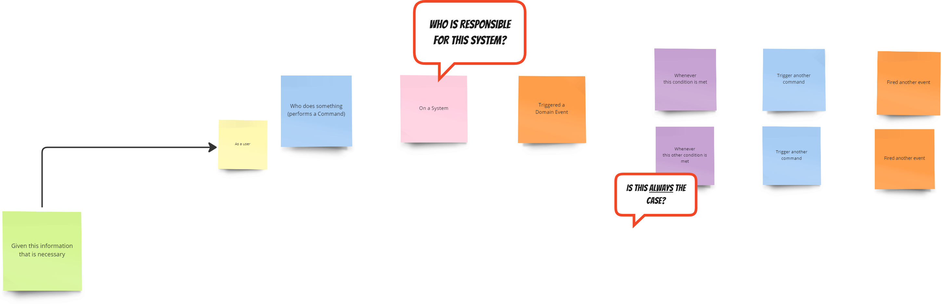
EventStorming Grammar
Notes:
We’re including this slide to show the grammar of all the sticky notes that we mention. This may not be covered in the 30-minute presentation

Slide 33
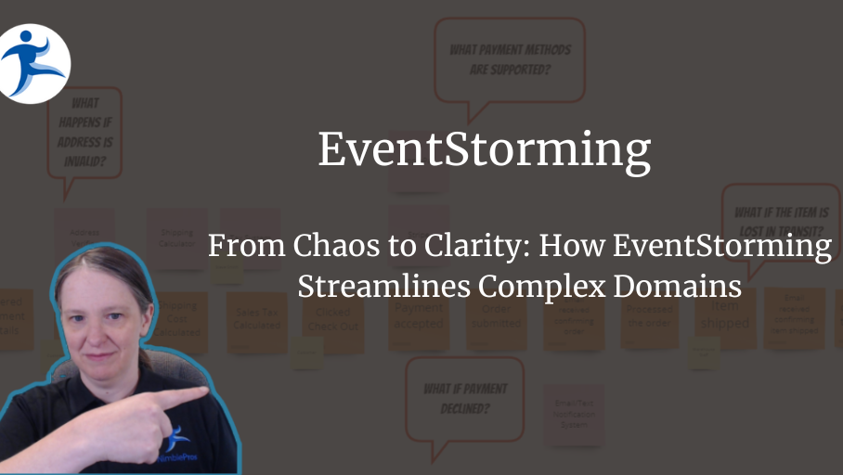
Webinar: EventStorming
On-Demand Webinar on EventStorming
https://bit.ly/eventstorming-video

Slide 34
More Resources
EventStorming.com
YouTube Video: 50,000 Stickies Later
YouTube Video: 100,000 Stickies Later
Book: EventStorming by Alberto Brandolini
Book: The EventStorming Handbook by Paul Rayner

Slide 35


Thank you!
/in/sadukie
sarah.dutkiewicz@nimblepros.com

